Slide 1

Go-to-Market (G2M)
Cab Industry Case Study
Siddhartha Vanam | Frederick, MD
Data and Analytics Team | March 11th, 2021

Slide 2
Agenda
Cab Industry Background
2 Company Analysis: Pink and Yellow Cab
Analysis
Data Understanding and Overview
Macro → Micro Profit Analysis

Slide 3
Cab Industry Background

Slide 4
Industry Disruption in the Cab Industry
Companies like Uber and Lyft have disrupted the Cab Industry with apps and on-demand ride services. Effects include:
Medallion taxi drivers committing suicide.
“By Q1 2018, ride-hailing had grabbed 70.5% of the market, with rental cars getting 23.5% and taxis just 6%.” ~Forbes₁
Taxi drivers lost consistent revenue and initial investment.
Cab companies have since responded by rolling out their own apps to take back market share.

Slide 5
Is the Cab Industry still profitable?
Pink Cab or
Yellow Cab Company?

Slide 6
Let’s FIND OUT!

Slide 7
Analysis - Data Overview and Understanding
Data Overview
MASTER DATA, composed of...
Cab_Data.csv → Routes and Prices
Customer_ID.csv→ Customer info
Transaction_ID.csv→ Payment Type
City.csv→ City Statistics
Total Features = 14
Feature Understanding
2 Main Companies: Pink and Yellow
Generated PROFIT feature as (Price_Charged - Cost_of_Trip)
Generated Seasonality Features: Month, Holidate, Timezone

Slide 8
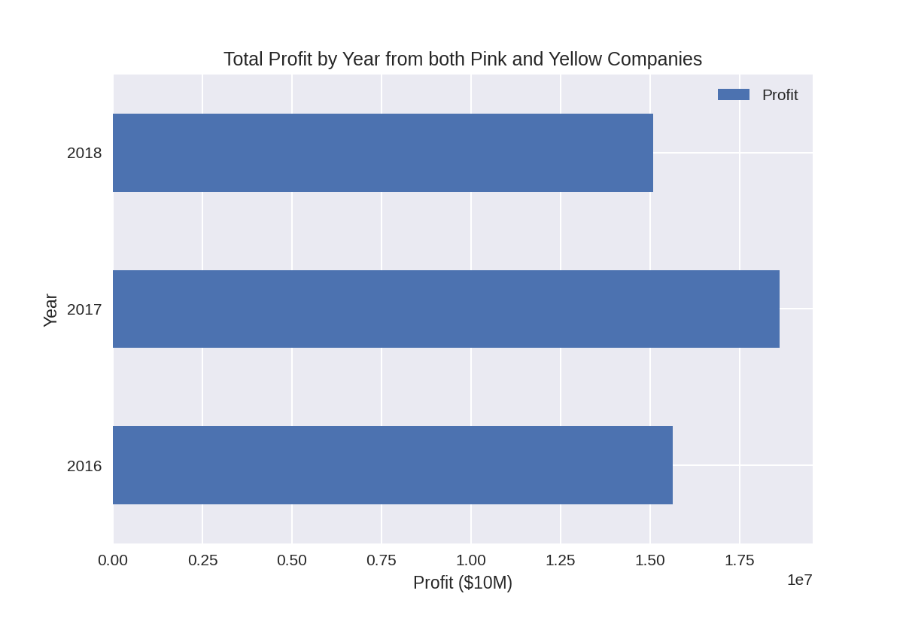
3 Year Profitability
+18.98%
2017 was the most profitable year generating $17.5M in Profit.
-18.98%

Slide 9
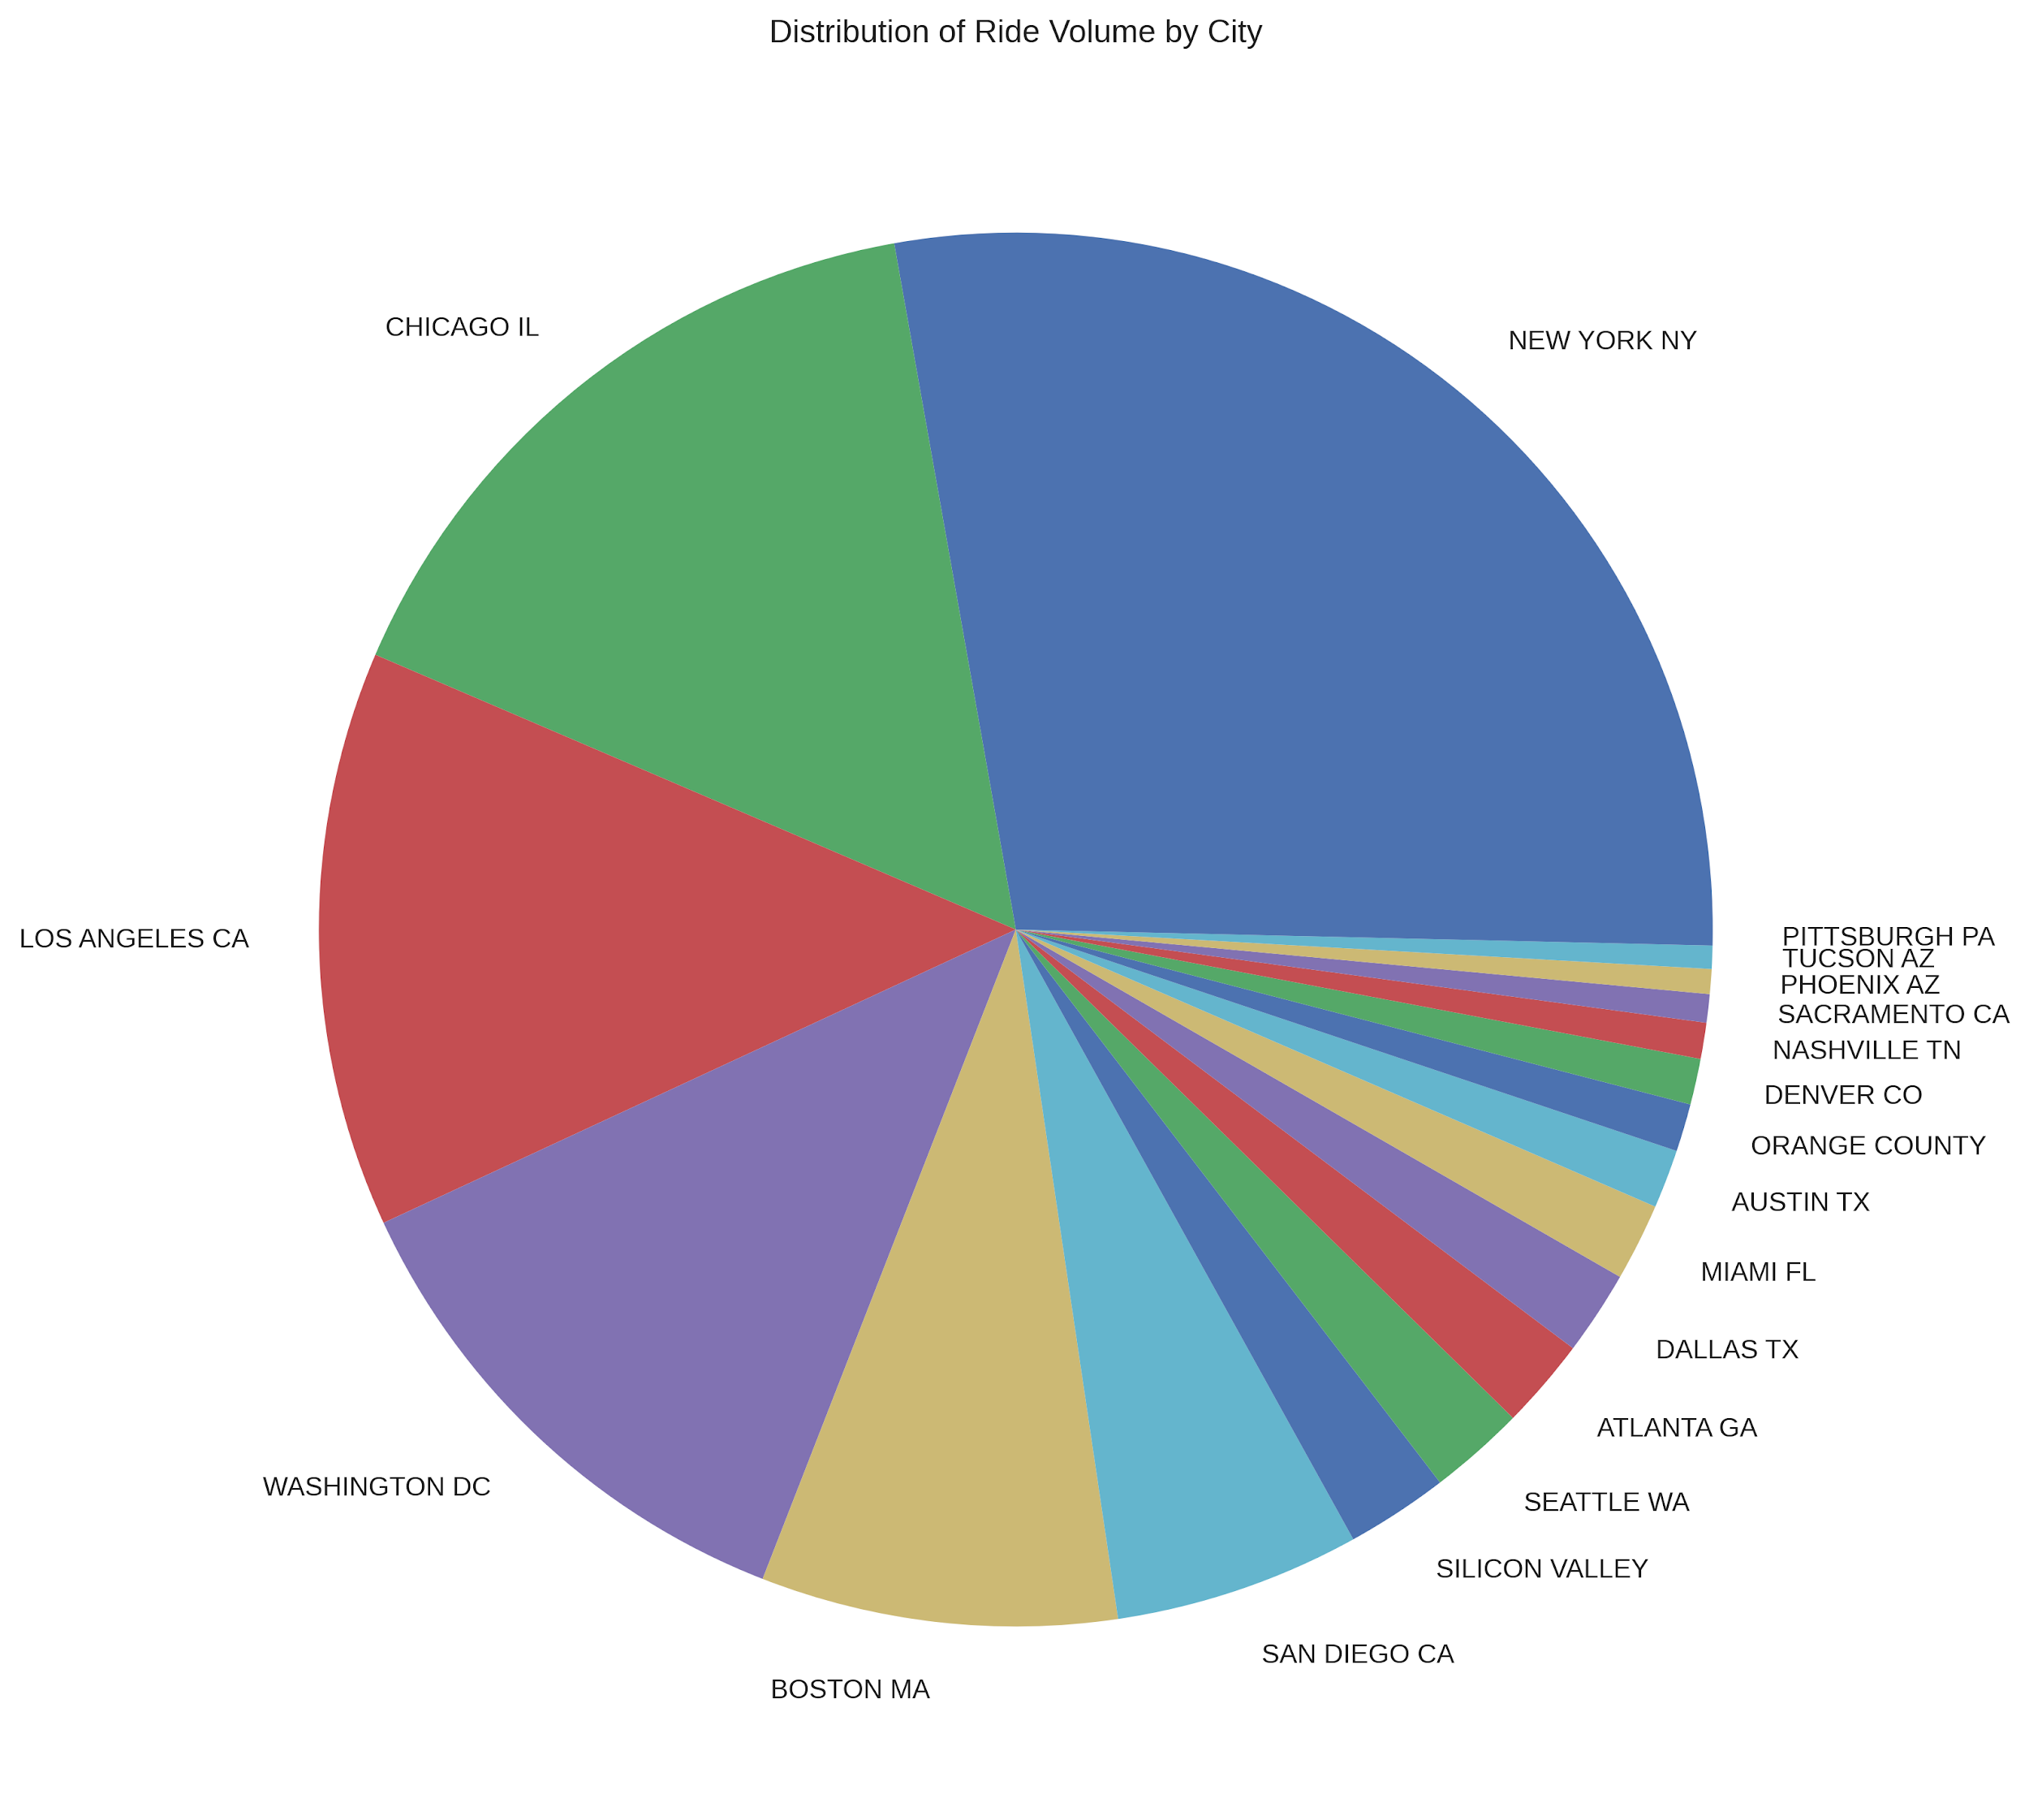
Company Ride Volumes
New York, Chicago and Los Angeles have >50% of the Ride Share Volume.

Slide 10
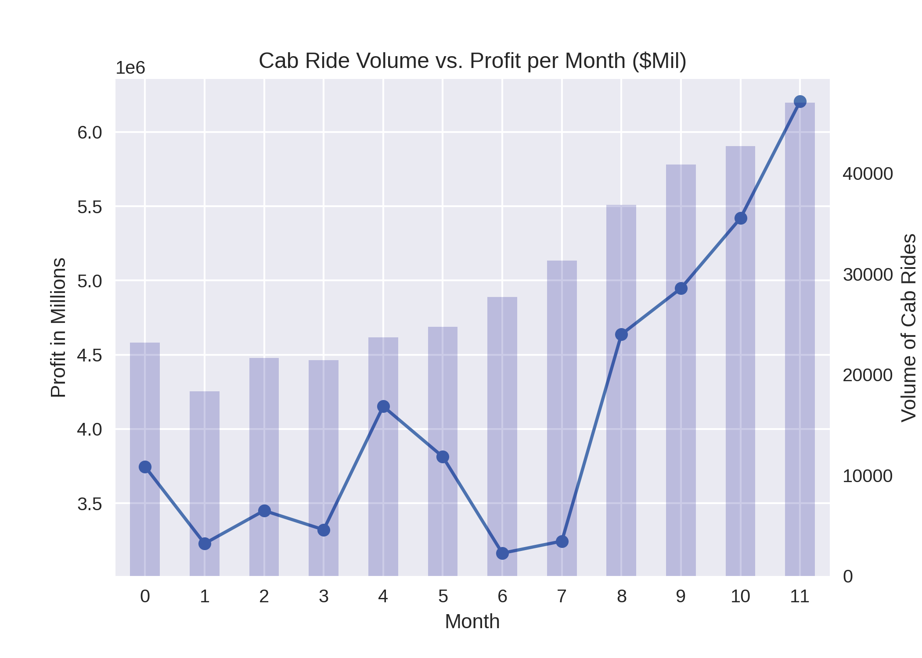
Monthly Seasonality
Winter was by far the most profitable season followed by the summer. Additionally, ride volume increased as the year went on.

Slide 11
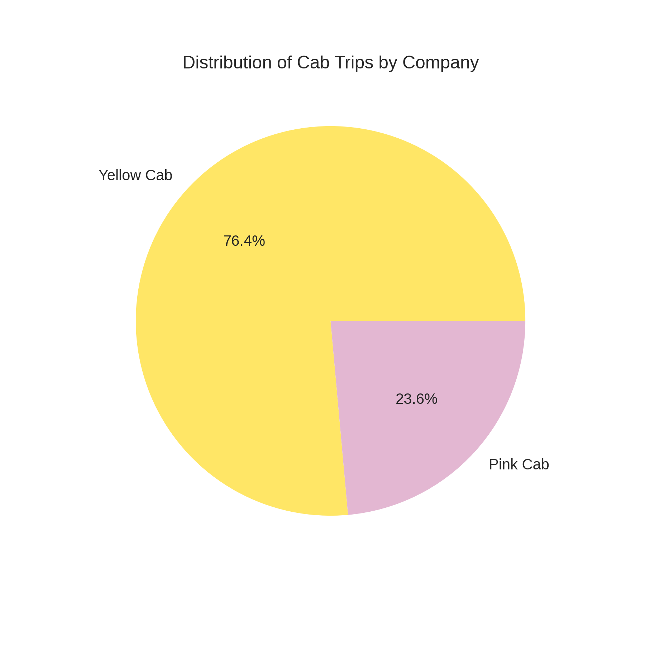
Company Ride Volumes
Yellow Cab Company has ~3x the Ride Volume of the Pink Cab Company.

Slide 12
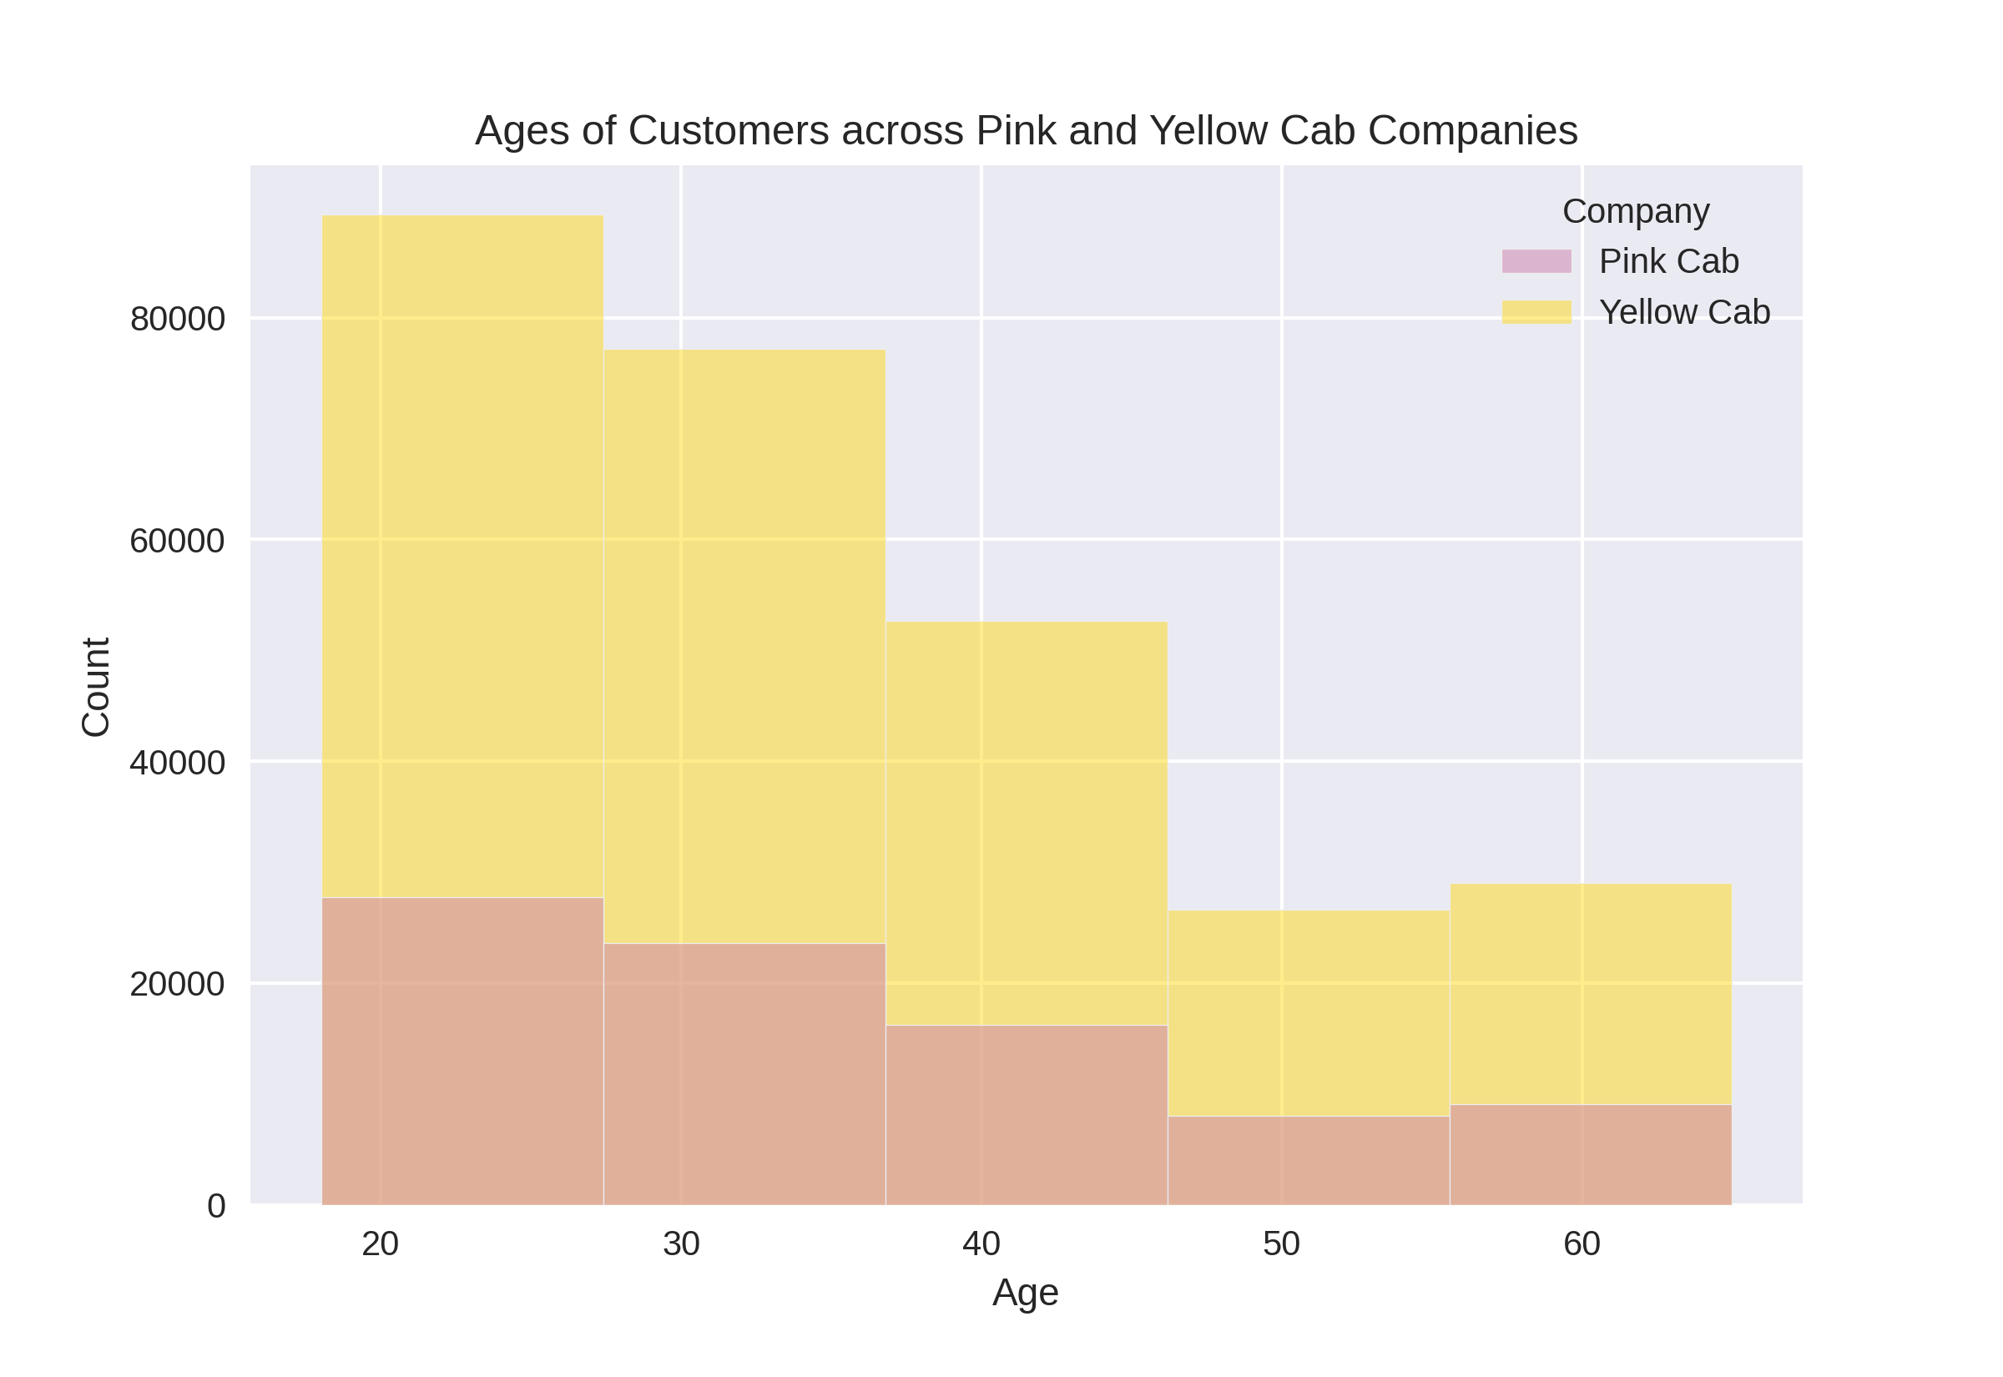
Customer Demographics
The younger, Millennials and Gen Zs are more frequent customers for both Companies.

Slide 13
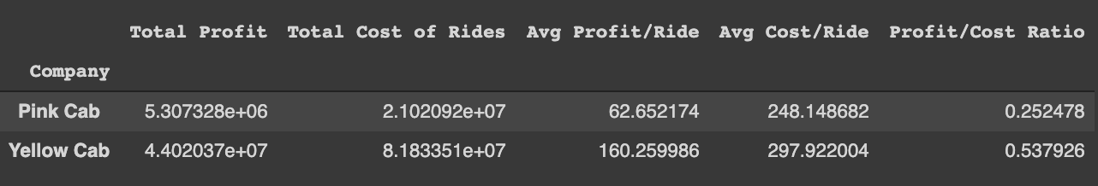
Company Ride Volumes
While Total Costs are 4x greater for Yellow Cab, the Average Cost/Ride is comparable with only a ~$49 difference.
According to the Profit/ Cost Ratio: Yellow Cab is 2x is efficient at producing a profit

Slide 14
Customer Retention by Company
16.9% 83.1% 43.6%
4.4% 95.6% 84.2%
Customers Used The Company ONLY 1x
Customers Used The Company > 1x
Customers Used The Company > 5x

Slide 15
Invest in Yellow Cab Company
✔️ Greater Market Share
✔️ Higher Demographic Coverage
✔️ Greater Profit/Cost Ratio
✔️ Industry Best Profit per Ride
✔️ Best Customer Retention amongst the Cab Companies

Slide 16
GitHub Link to Code and Data
GitHub: https://github.com/siddley1001/DG_internship
ReadMe: Motivation and Requirements
EDA: Visualizations and Feature Engineering
Machine Learning Regression Pipelines

Slide 17
THANK YOU!
Email Questions and Collaboration Requests to: vanamsid@live.unc.edu

Slide 18
CREDITS.
https://www.forbes.com/sites/michaelgoldstein/2018/06/08/uber-lyft-taxi-drivers/?sh=102eff59f0d9
Data provided by the Data Glacier Team.
Notes:
Presentation Template: SlidesMania
Images: Unsplash

